Slide 1
Welding Fundamentals
CSA & ASME Section IX
By: Gregory Lightheart, P.Eng.
Copyright 2016 Lightheart Consulting Inc.

Slide 2
Agenda
Overview
Topics Covered
How does welding apply to the midstream pipelines and oil and gas industry?
Examples (WPS, PQR, WQR, Weld Details)
Key Take Aways
Wrap Up
Copyright 2016 Lightheart Consulting Inc.

Slide 3
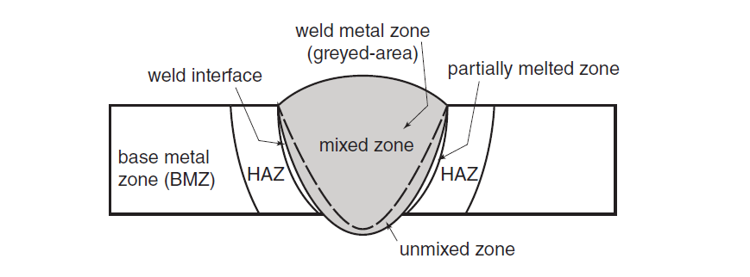
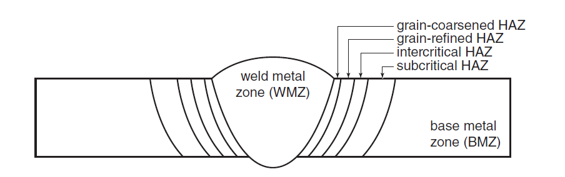
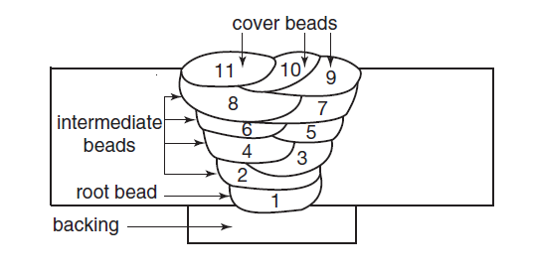
Defining the Weld & Weld Metallurgy
Various Weld Zones:
  Weld Metal Zone
    Mixed Zone
    Un-Mixed Zone
  Weld Interface
  Partially Melted Zone
  Heat Affected Zone (HAZ)
    Grain-Coarsened HAZ
    Grain-Refined HAZ
    Intercritical HAZ
    Subcritical HAZ
  Base Metal Zone (BMZ)
Weld Sequence:
  Root Pass / Backing Weld
  Single Hot Pass
  Fill Passes
  Cap / Cover Passes
  Back Weld (if applicable)
Weld Pass and Weld Bead
Copyright 2016 Lightheart Consulting Inc.

Slide 4
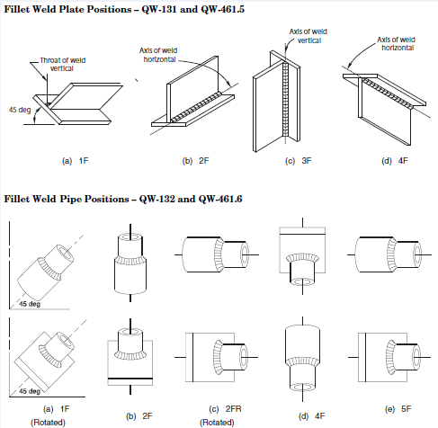
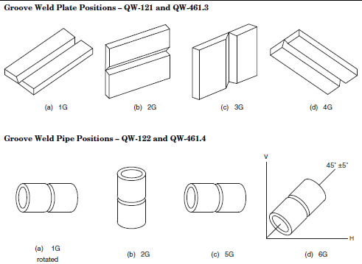
Weld Positions
All welds can be simplified into a number of common weld positions
  (eg. Flat, horizontal, vertical, overhead)
When welding in vertical position, changing weld progression (vertical up/vertical down) is of particular importance – as opposed to other weld positions
Copyright 2016 Lightheart Consulting Inc.

Slide 5
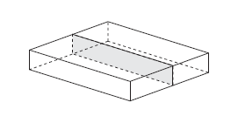
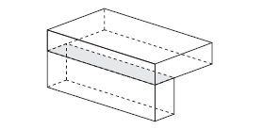
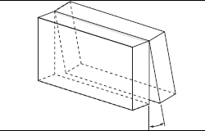
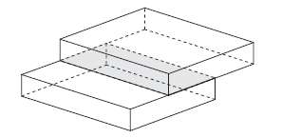
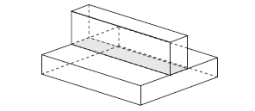
Weld Joint Types
BUTT JOINT
CORNER JOINT
EDGE JOINT
LAP JOINT
T JOINT
Selecting the correct joint type considers:
  Minimum weld metal required to fill the joint
  Weld process & available equipment
  Accessibility & weld position
  Plate thickness & preparation equipment available
Copyright 2016 Lightheart Consulting Inc.

Slide 6
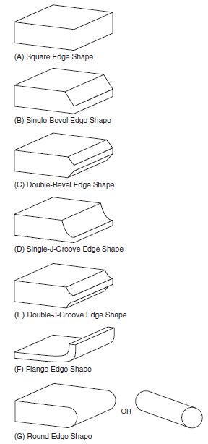
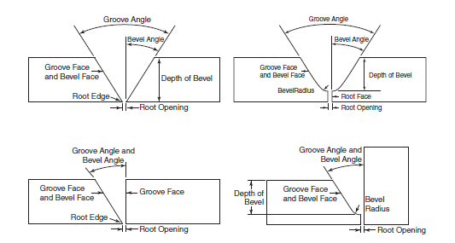
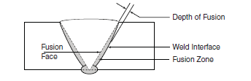
Edge Preparation & Joint Design Geometry
Standard welding terms to describe the type of weld joints
Common Edge Shapes
A well designed end preparation will increase overall weld quality, efficiency, and minimize costs.
Copyright 2016 Lightheart Consulting Inc.

Slide 7
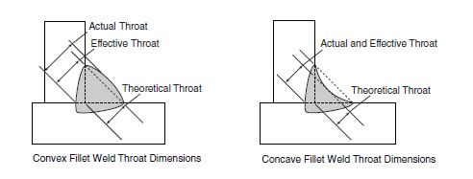
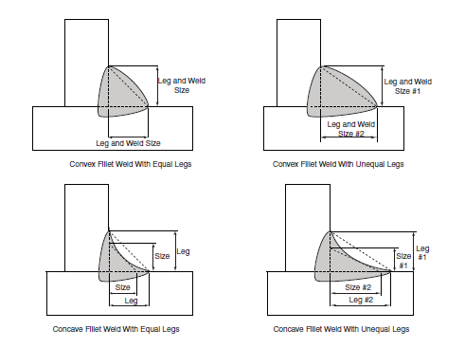
Fillet Weld – Joint Geometry
Fillet welds are sized by their LEG length
Can be slightly convex or concave
Theoretical throat is used for design purposes
Copyright 2016 Lightheart Consulting Inc.

Slide 8
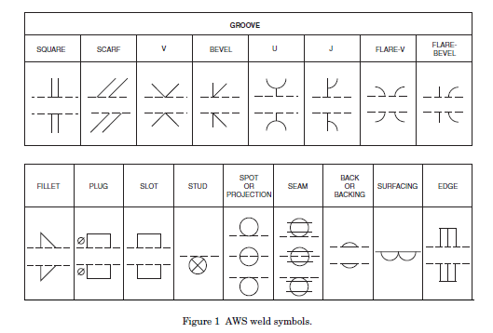
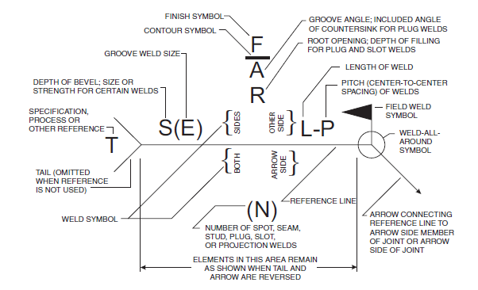
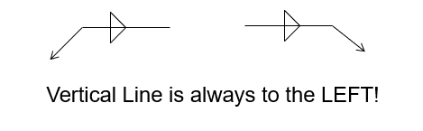
Weld Symbols
Basic Weld Symbols Used
Copyright 2016 Lightheart Consulting Inc.

Slide 9
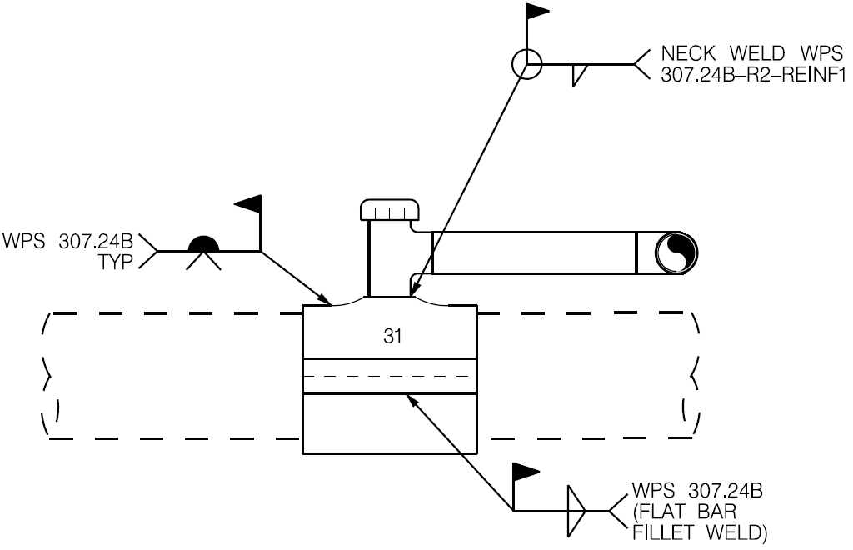
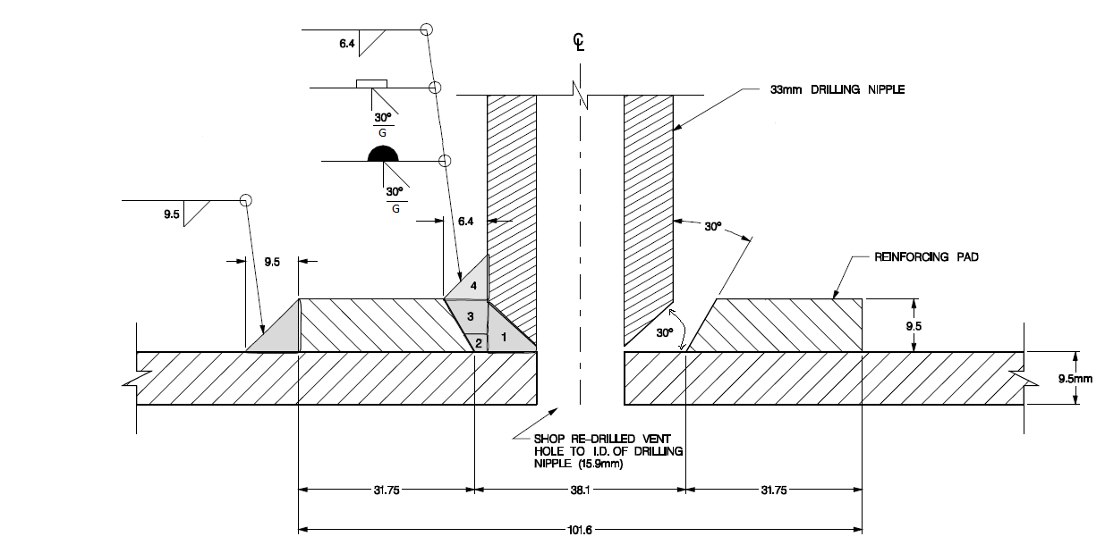
Examples - #1
Q1: Describe the Highlighted Weld
-Single fillet weld on arrow side
-Weld all-around
-Field weld
-Weld using WPS 307.24B-R2-REINF1
Q2: Describe the Highlighted Weld
(Hint: start with symbol closest to the arrow)
Single 30º bevel weld w/ melt-through, on arrow side, all-around, grind flat (weld item 1)
Single 30º bevel weld w/ backing, arrow side, all-around, grind flat (weld items 2 and 3)
Single 6.4 mm leg length (size) fillet weld, arrow side, all around (weld item 4)
Copyright 2016 Lightheart Consulting Inc.

Slide 10
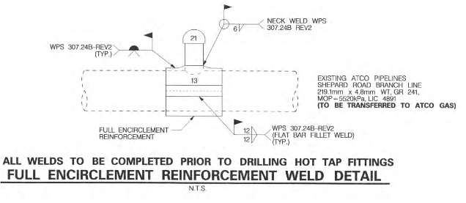
Examples #2
Q3: Describe the Highlighted Weld
- Fillet weld on both sides of bar (arrow side and other side)
- Leg length (size) is 12 mm
- Field weld
- Weld using WPS 307.24B-Rev2
Copyright 2016 Lightheart Consulting Inc.

Slide 11
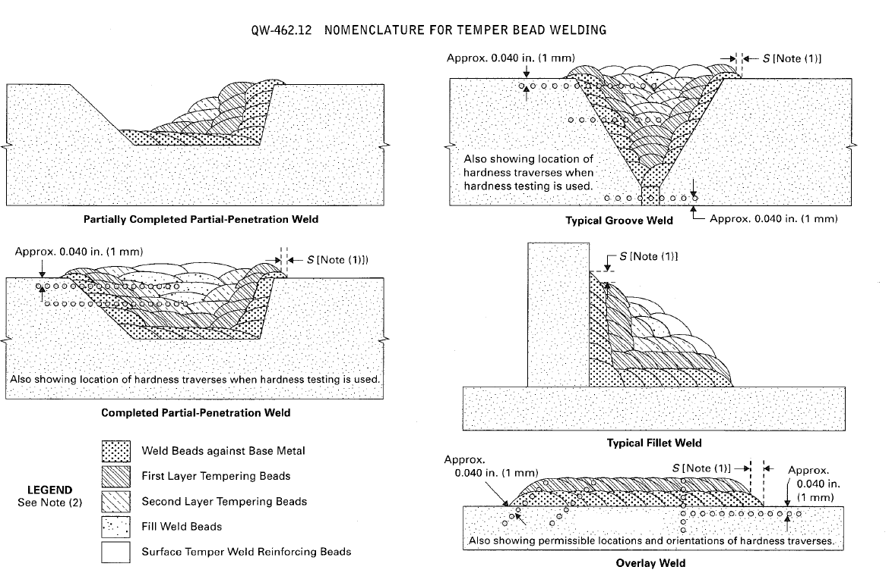
Temper Beading Welding
Temper Bead Welding:
  A weld consisting of weld beads placed such that each subsequent weld layer “tempers” the previously deposited weld metal layers
  Purpose is to achieve desired metallurgical properties of weld metal and heat affected zone
Copyright 2016 Lightheart Consulting Inc.

Slide 12
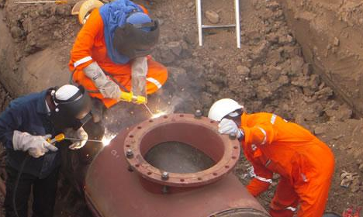

In-Service Welding Using Temper Bead
Some common applications, such as in-service welding, may utilize Temper Bead Welding
In-Service Welding Considerations:
  Cooling Rate - pipe acts as an infinite heat sink, cooling rate becomes a concern
  Heat Input - ensure no burn-through and maintain certain level of wall thickness in tact
$$Q \left[\frac{J}{in}\right]=\left(\frac{V\left[volt\right]∗I\left[amps\right] }{v \left[travel speed, in/min\right]}\right)∗\frac{60 [sec]}{1 [min]}$$
Simplified Heat Input Equation
Copyright 2016 Lightheart Consulting Inc.

Slide 13
Welding Processes & Cutting Processes
Fusion Weld Processes
Shielded Metal Arc Welding (SMAW)
  Common in pipe joining, manual, referred to as “stick welding”, slag needs to be removed
Gas Metal Arc Welding (GMAW) or Metal Inert Gas (MIG) Welding
  Common in shop fabrication, usually semi-automated, wire feed system
Flux Cored Arc Welding (FCAW)
  Common in shop fabrication, usually semi-automated, wire feed system, flux turns to slag that needs to be removed
  Note: Calgary Bow Tower framing was entirely welded using FCAW
Gas Tungsten Arc Welding (GTAW) or TIG welding
  Common for welding root pass due to higher precision and control of weld pool, and other welding parameters
Submerged Arc Welding (SAW)
  Common in pipe manufacture, mostly entirely automated with a weld operator not a welder
  Usually in flat (1-G) position as flux needs to sit in weld joint as the longitudinal weld
  For shop welding using SAW the pipe is rolled while machine stays in position
Highlighted processes discussed on next slides
Cutting Processes
Oxygen Cutting (OC)
Arc Cutting (AC)
Copyright 2016 Lightheart Consulting Inc.

Slide 14
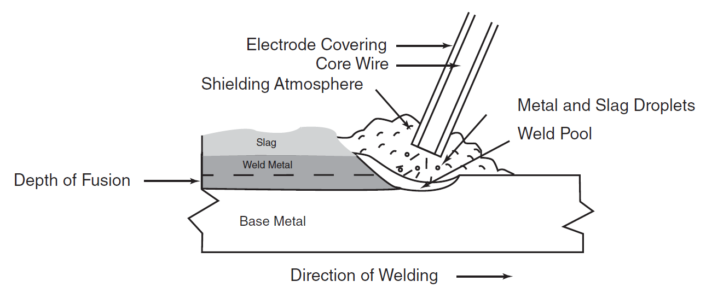
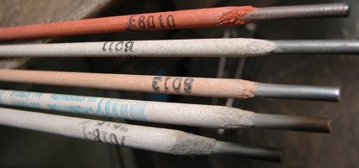
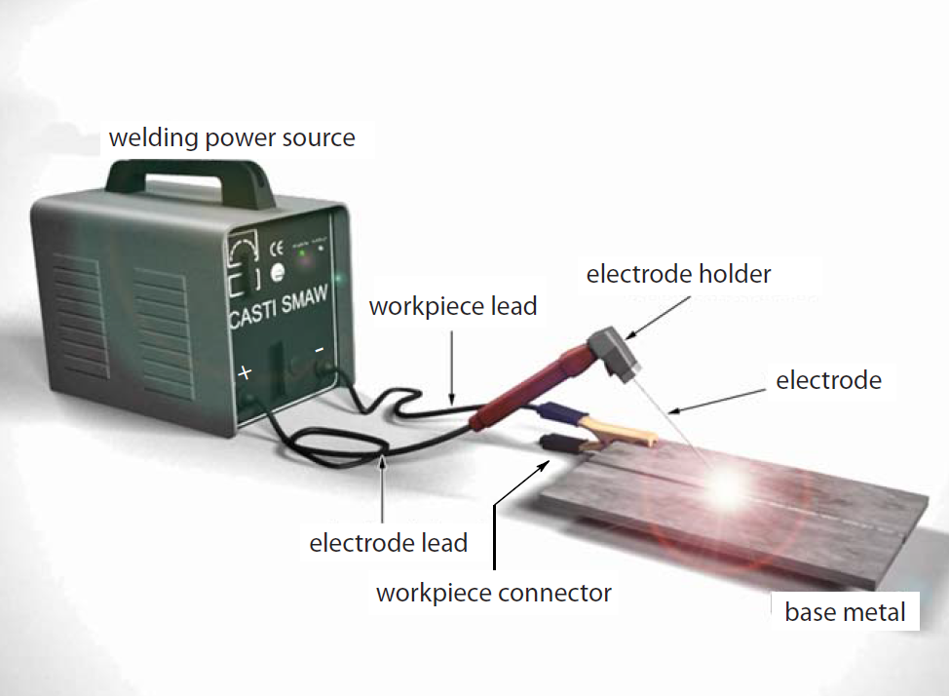
Shielded Metal Arc Welding (SMAW)
Manual Weld Process
Welding electrode contains filler metal core and flux exterior
Consumed electrode produces weld metal, protective slag, and shielding atmosphere
Purpose of flux is to remove impurities from weld pool, provide inert shielding gas, and slag continues to protect weld metal until hardened and physically removed
Copyright 2016 Lightheart Consulting Inc.

Slide 15
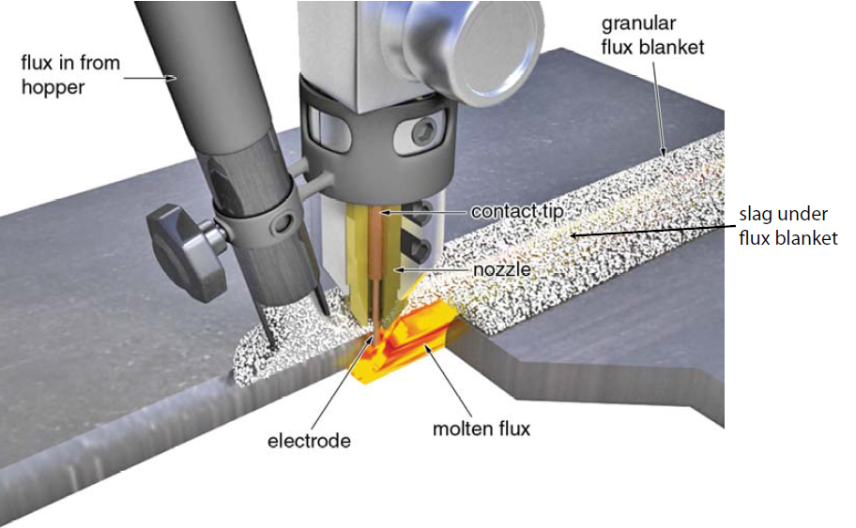
Submerged Arc Welding (SAW)
Automatic / Mechanized Weld Process
Uses granular flux fed through a hopper
Weld arc is ‘submerged’ under the granular flux
Achieves the highest level of weld deposit rates out of any other process, highest productivity but limited to repeatable welds in the flat position
-Unused flux may be recycled
-Small amounts of slag often re-crushed and
mixed with new flux before being used
Copyright 2016 Lightheart Consulting Inc.

Slide 16

Non-Destructive Testing (NDT)
Visual Testing (VT)
Magnetic Particle Testing (MT)
Liquid Penetrant Testing (PT)
Ultrasonic Testing (UT)
Radiographic Testing (RT)
  Commonly called X-Ray though Gamma-Ray is more often utilized
Copyright 2016 Lightheart Consulting Inc.

Slide 17
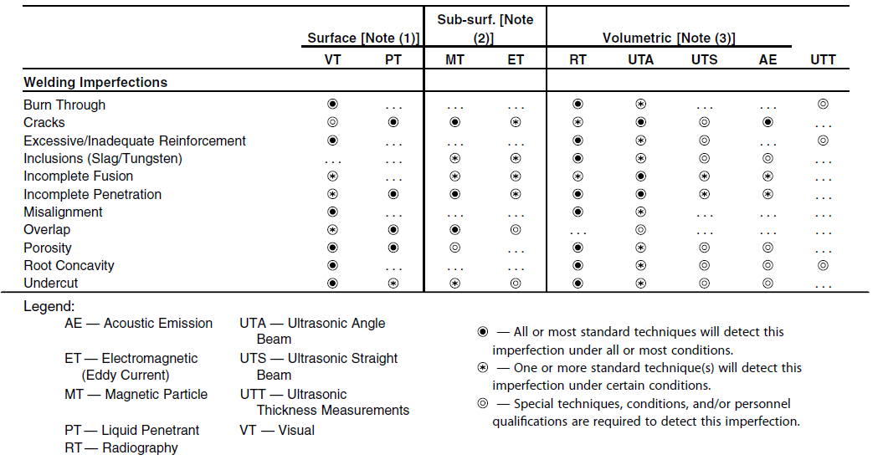
Weld Imperfections vs. NDT Method
Imperfection vs Type of NDT Method
Copyright 2016 Lightheart Consulting Inc.

Slide 18
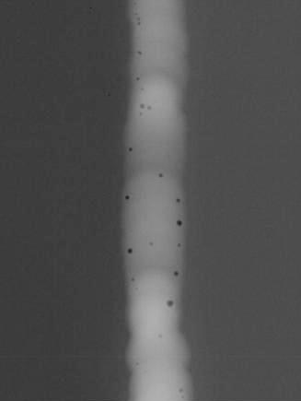
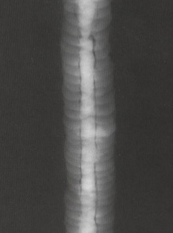
What Type of Weld Defect?
Q1
Q2
POROSITY
SLAG INCLUSIONS
Copyright 2016 Lightheart Consulting Inc.

Slide 19
WPS / PQR / WPQR
Weld Procedure Specification (WPS)
    Defines weld variables & parameters to adhere to during welding
    Some variables (called non-essential variables) may be changed by the company without re-qualification (as defined in ASME BPVC Section IX), but the changes MUST be documented and approved by the company based on good engineering judgment (e.g. straight vs. weaving weld progression)
Procedure Qualification Record (PQR)
    Record qualifying a WPS
    Includes non-destructive and destructive test results (e.g. guided bend test, tensile)
Welder Performance Qualification Record (WPQR)
    Record qualifying of a welder performing a certain weld procedure to specification
RECIPE
TASTE TEST
ANOTHER CHEF’S ABILITY TO REPLICATE THE SAME RECIPE
Copyright 2016 Lightheart Consulting Inc.

Slide 20
WPS/PQR/WPQR
Review WPS Examples

Slide 21
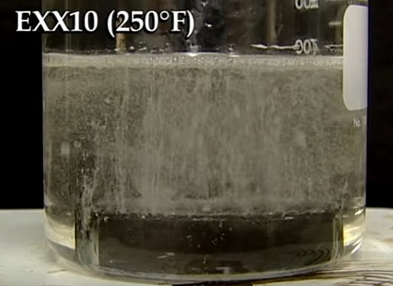
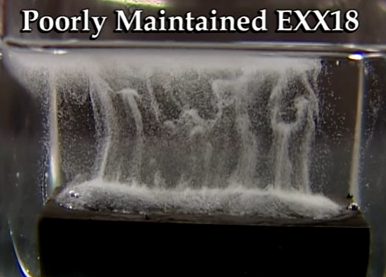
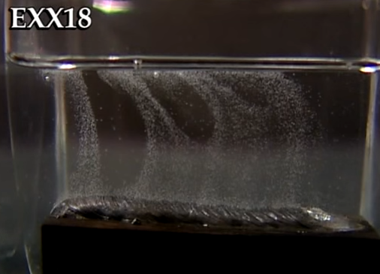
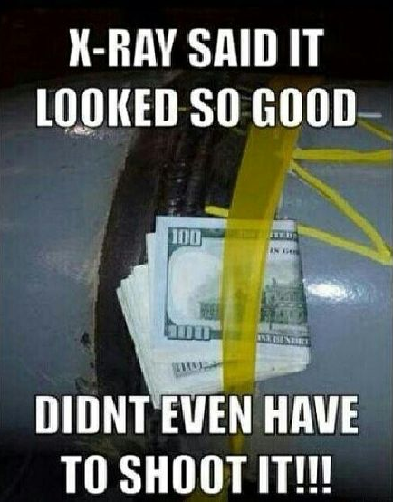
Industry Transition & Lessons Learned
Diffused Hydrogen Comparison
  Pipelines Continuous Improvement
  Assess value for increased use of low-hydrogen electrodes to reduce probability of HIC (Hydrogen Induced Cracking)
  Evaluate NDT methods and select best NDT methods based on imperfection modes (UT / RT)
  Evaluate chosen weld process to be used based on weld quality, efficiency, and costs. (SMAW vs GMAW, etc.)
Standard Electrode
Low-Hydrogen Electrode (poorly stored)
Low-Hydrogen Electrode
NDT is critical – Don’t Do THIS!
Copyright 2016 Lightheart Consulting Inc.

Slide 22
References
CASTI “Welding Fundamentals” Course Handbook
ASME BPVC - Section V “Non-Destructive Examination”, 2010 Edition
ASME BPVC - Section IX “Welding and Brazing Qualifications”, 2010 Edition
Interested in More?
Courses available:
Program offered by ‘Codes and Standards Training Institute’ (CASTI) “Welding Fundamentals” & “ASME Section IX”
Targeted towards: Engineers, QA/QC Personnel, Inspectors, Welders, and Project Managers
Beneficial for people with various degrees of welding knowledge and experience
Paths to become qualified W47.1 Weld Engineer and ABSA Weld Examiner by trade
https://www.absa.ca/examination-and-certification/welders-welding-examiners/welding-examiner-welding-examiner-in-training/welding-examiner/
Copyright 2016 Lightheart Consulting Inc.

Slide 23
QUESTIONS?
Copyright 2016 Lightheart Consulting Inc.

